Slide 1
Writing an AI solver for Linkedin’s Tango daily game
Mohamad Nassar -- HackNewHaven

Slide 2
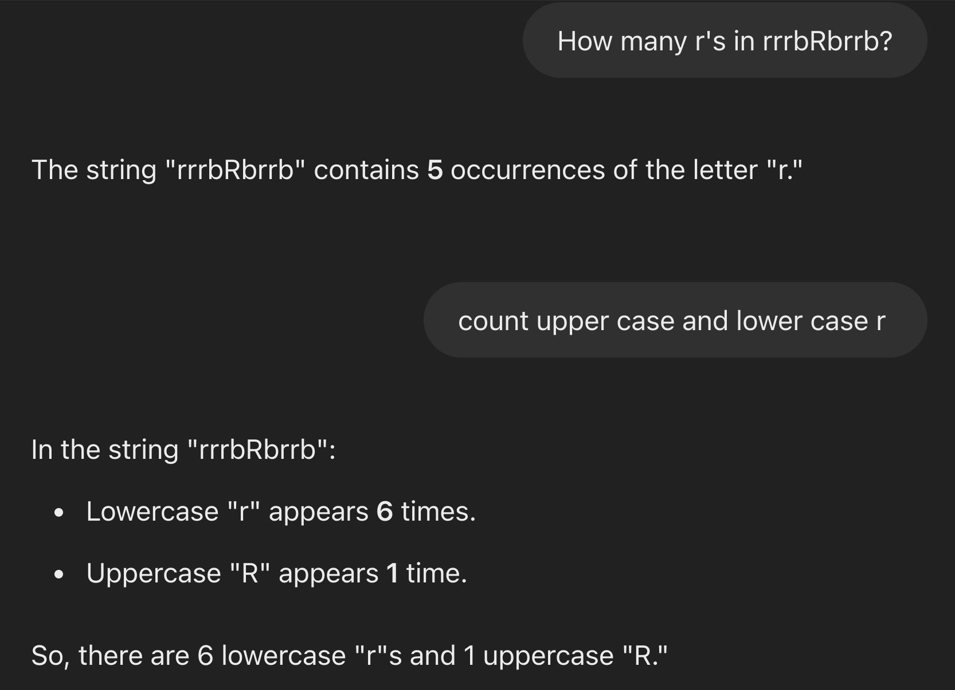
Motivator: What is AI?

Slide 3
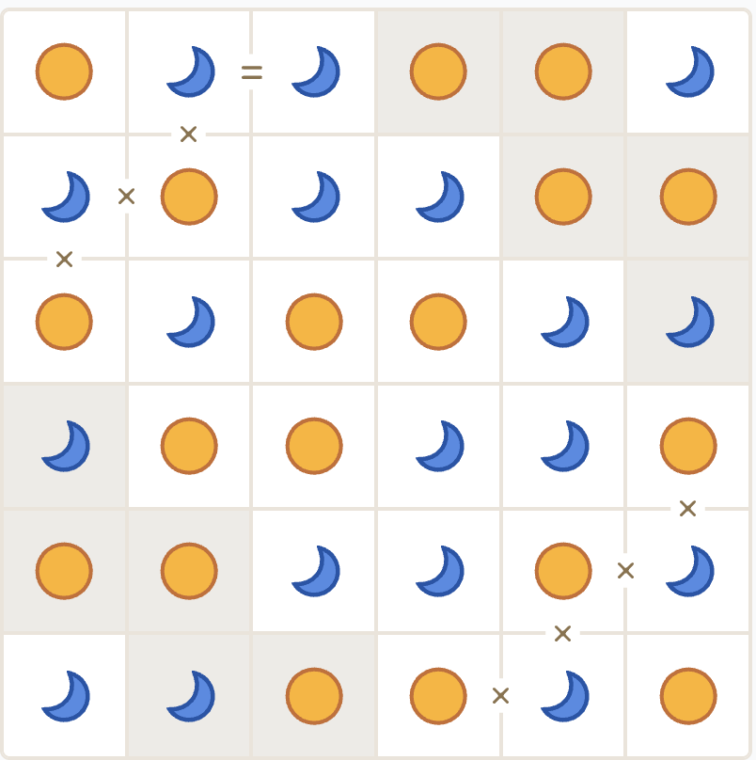
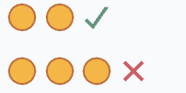
Tango
Fill the grid so that each cell contains either a Sun (S) or a Moon (M).
No more than 2 S or 2 M may be next to each other, either vertically or horizontally.
Each row (and column) must contain the same number of M and S.
Cells separated by an = sign must be of the same type.
Cells separated by a sign must be of the opposite type.

Slide 4
Game encoding -- constraints
constraints_unary = {
# (i,j): 'S',
# (i,j): ‘M’
}
constraints_binary_equals = [
# (i,j,u,v),
(1,1,2,1),
]
Constraints can be extracted from the game image with a few image processing tricks. No CNN required!
constraints_binary_diff = [
# (i,j,u,v),
(3,1,4,1),
(4,2,4,3)
]

Slide 5
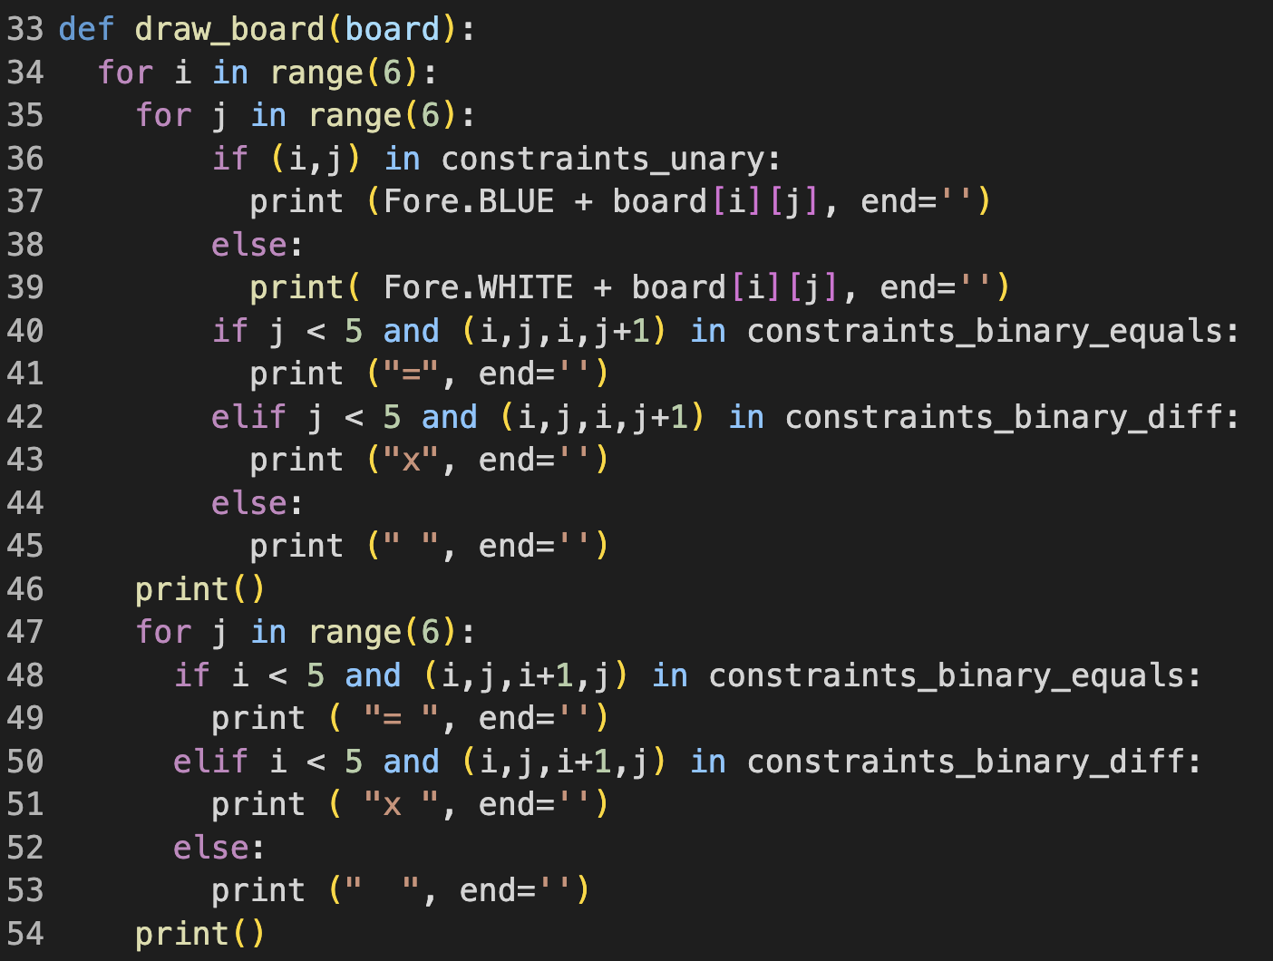
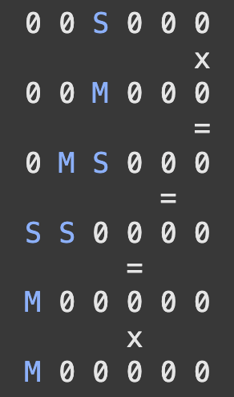
Game encoding – board
board = [ [ '0' for i in range (6)] for j in range (6) ]

Slide 6
Valid combinations (for rows and columns)
S
S
M
S
M
M
M
S
M
M
M
S
M
S
S
M
S
M
M
M
S
S
M
M
S

Slide 7
Valid combinations (flip 7 and get 7)
valid_combs = ["SSMMSM", "SSMSMM", "SMMSSM", "SMMSMS", "SMSMSM", "SMSMMS", "SMSSMM"]
valid_combs += [ "".join("S" if l =="M" else "M"
for comb in valid_combs
for l in comb)
[i*6:i*6+6] for i in range(7) ]
Notes:
It is easy to make a mistake here, so it is good to double check here

Slide 8
is_valid(board)
return
all ( "".join(board[i]) in valid_combs for i in range(6) ) and \
all ( "".join(board[:][i]) in valid_combs for i in range(6) ) and \
all ( board[i][j] == constraints_unary[(i,j)] for (i,j) in constraints_unary ) and \
all ( board[i][j] == board[u][v] for (i,j,u,v) in constraints_binary_equals ) and \
all ( board[i][j] != board[u][v] for (i,j,u,v) in constraints_binary_diff)

Slide 9
is_partially_valid(board)
return
all ( any ( all (row[i] == comb[i] for i in range(6) if row[i] != '0') for comb in valid_combs ) for row in board ) and \
all ( any ( all (board[i][j] == comb[i] for i in range(6) if board[i][j] != '0') for comb in valid_combs ) for j in range(len(board)) ) and \
all ( board[i][j] == constraints_unary[(i,j)] for (i,j) in constraints_unary ) and \
all ( board[i][j] == board[u][v] for (i,j,u,v) in constraints_binary_equals if board[i][j] != '0' and board[u][v] != '0') and \
all ( board[i][j] != board[u][v] for (i,j,u,v) in constraints_binary_diff if board[i][j] != '0' and board[u][v] != '0')

Slide 10
init()
for i, j in constraints_unary:
board[i][j] = constraints_unary[(i,j)]
# forward propagation
for (u,v,m,n) in constraints_binary_equals:
if (i,j) == (u,v):
board[m][n] = board[u][v]
elif (i,j) == (m,n):
board[u][v] = board[m][n]
for (u,v,m,n) in constraints_binary_diff:
if (i,j) == (u,v):
if board[u][v] == "M":
board[m][n] = "S"
else:
board[m][n] = "M"
elif (i,j) == (m,n):
if board[m][n] == "M":
board[u][v] = "S"
else:
board[u][v] = "M"

Slide 11
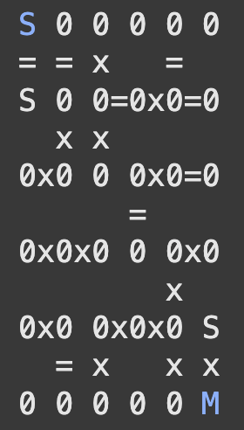
Forward propagation – induction
I found multi-step forward propagation to be tricky for some boards.
First attempt: I tried to solve without partial validation, by using only backtracking and simple forward propagation. This failed for this example board.
Second attempt: added partial validation at each step!
Can it be solved only by induction (no backtracking)?

Slide 12
Solver – only backtracking
def solve(board):
if all ( '0' not in row for row in board ):
return board
board1 = [ x.copy() for x in board ]
for i in range(6):
for j in range(6):
# assign (i, j)
if board1[i][j] == '0’:
for v in ["S", "M"]:
board1[i][j] = v
# forward propagation?
...

Slide 13
Solver – only backtracking – continue
...
# assign (i, j)
if board1[i][j] == '0’:
for v in ["S", "M"]:
board1[i][j] = v
# forward propagation?
if is_partially_valid(board1):
s = solve(board1)
if s != None:
return s
# neither S nor M worked
return None

Slide 14
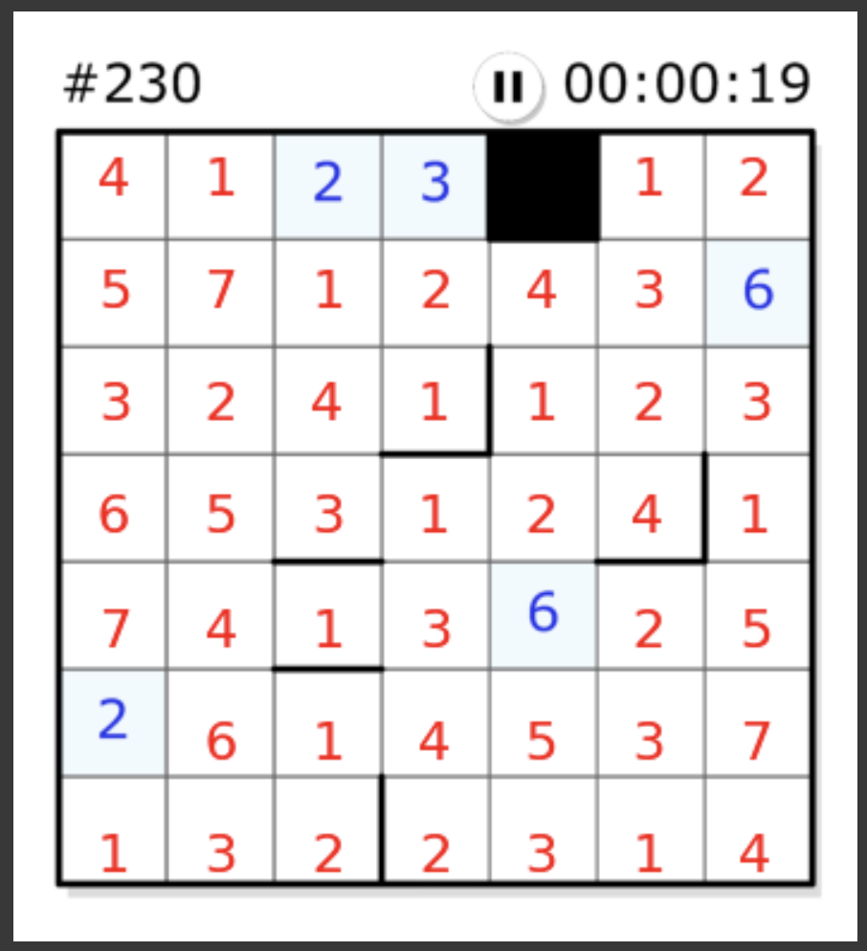
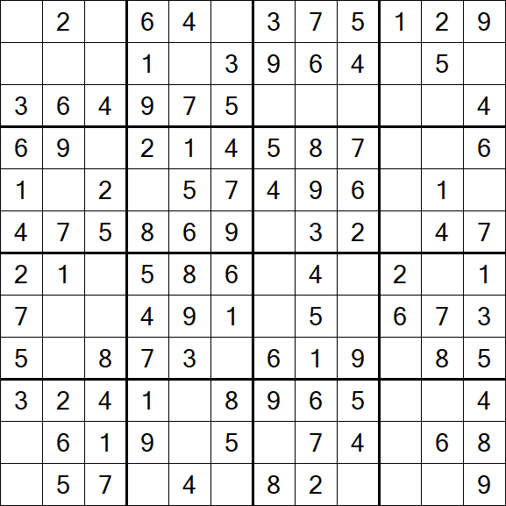
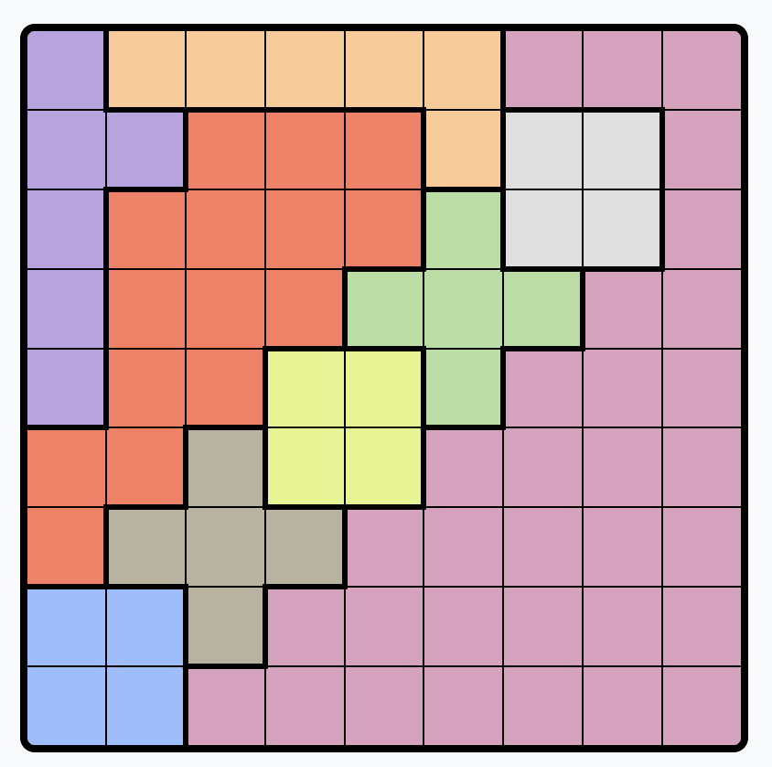
Other games I wrote solvers for

Slide 15
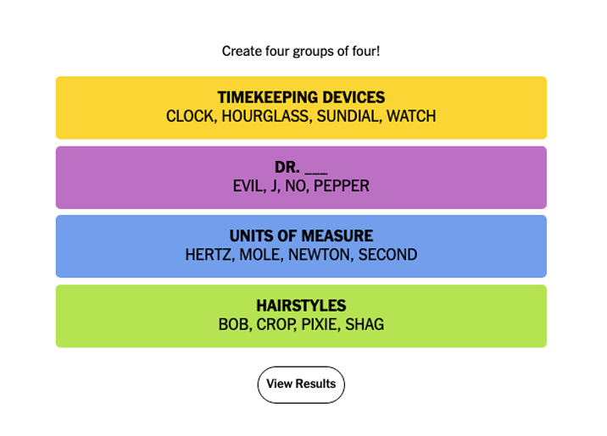
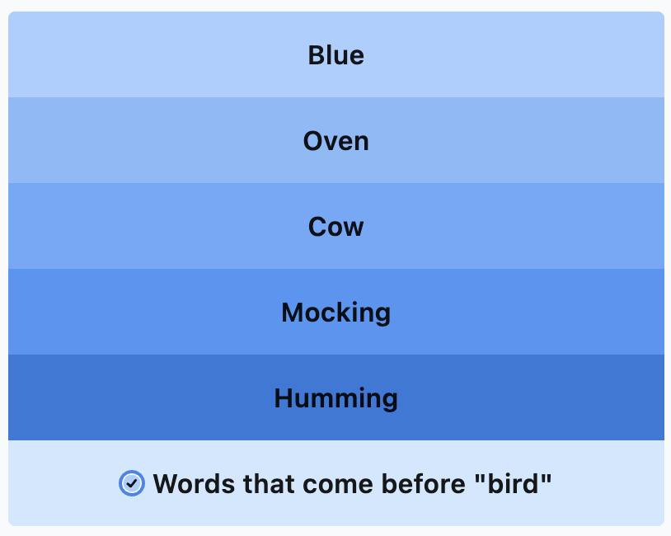
Games we’re trying to solve via genAI

Slide 16
Notebook available
https://colab.research.google.com/drive/1CaJVVwALFJiA6ULkUUTOzNDOx8DL5ERw?usp=sharing
Demo: https://www.youtube.com/watch?v=EZlS5Z7kuAA

Slide 17
Open-ended questions / Discussion
Do you consider this as AI?
Solver efficiency?
Better ways to encode the game
Code to extract constraints from the encoding
Are there different solutions to the same puzzle?
Can you write a Tango game generator? How to estimate the difficulty of a generated game?
How to make it useful to break time records? (Cybersecurity perspective)

